Slide 1
Final Project:
Maternal Health Risk Data
Cassidy Hay

Slide 2
OBJECTIVE
Option 3: Analyzing a dataset that uses data wrangling and modeling tools in R
Data: Dataset on maternal health risk data
Goal: Utilize the topics taught in this class to evaluate which health conditions are the strongest indications for health risks during pregnancy
Plan: Reshape the data, create a data frame, visualize the relationships, and build a linear regression model

Slide 3
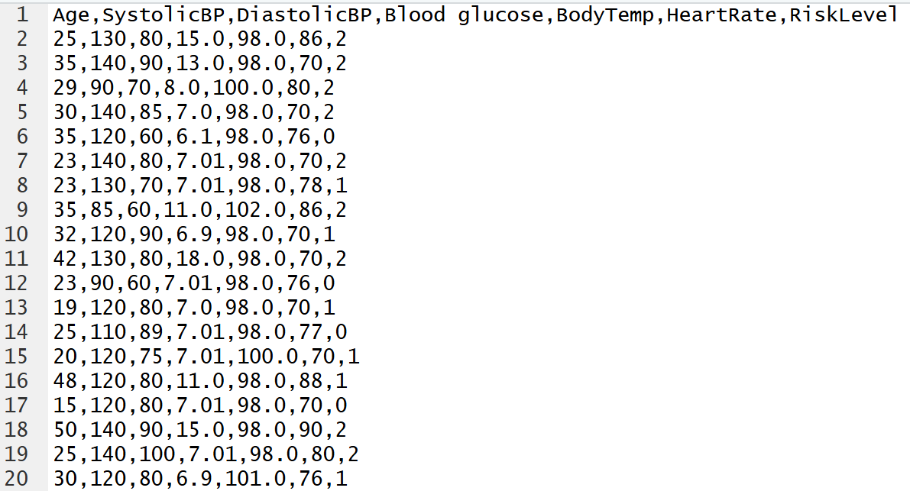
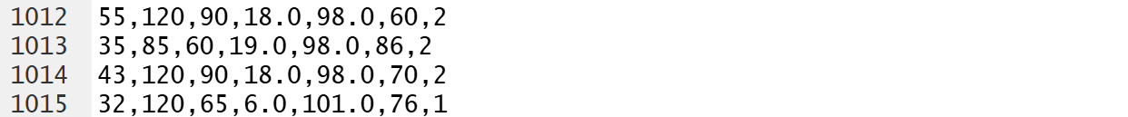
DATA SET AND SOURCE
Source: Kaggle
Data has been collected from different hospitals, community clinics, maternal health cares through the IoT based risk monitoring system.
Age: Age in years when a woman is pregnant
SystolicBP: Upper value of Blood Pressure in mmHg, another significant attribute during pregnancy
DiastolicBP: Lower value of Blood Pressure in mmHg, another significant attribute during pregnancy
Blood glucose: Blood glucose levels is in terms of a molar concentration, mmol/L.
Body temp: Collected in Fahrenheit
HeartRate: A normal resting heart rate in beats per minute
Risk Level: Predicted Risk Intensity Level during pregnancy considering the previous attribute

Slide 4
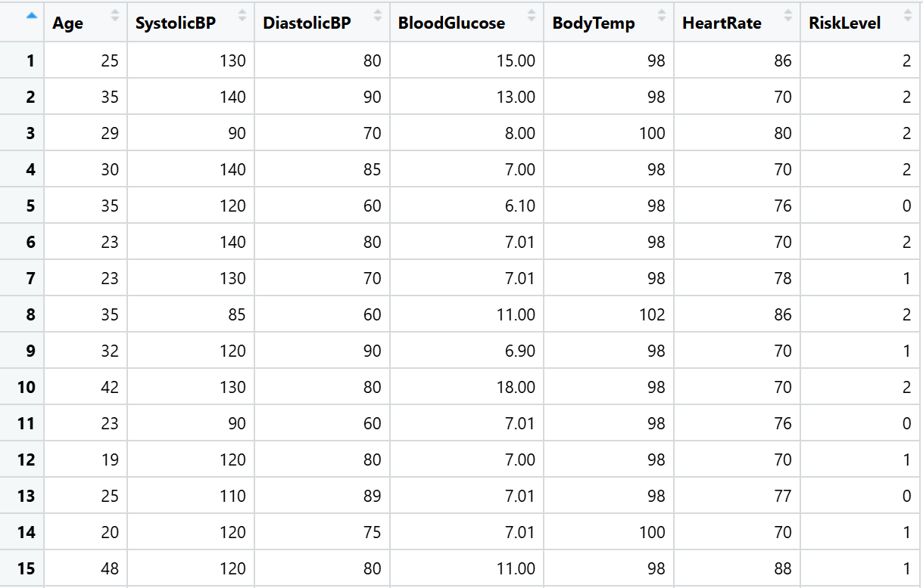
LOAD DATA SET AND DATA CLEANING
# setting working directory and reading data from csv file
setwd("C:/Users/cassi/Final-Project")
maternal_data <- read.csv("Maternal_Health_Risk_Assessment_Original_Dataset.csv",
sep = ",", header = TRUE)
# clean up the column names
setnames(maternal_data, "Blood.glucose", "BloodGlucose")
# convert to data table
library(data.table)
maternal_dt <- as.data.table(maternal_data)
# convert to numeric
cols <- c("Age", "SystolicBP", "DiastolicBP", "BloodGlucose", "BodyTemp",
"HeartRate")
maternal_dt[, (cols) := lapply(.SD, as.numeric), .SDcols = cols]

Slide 5
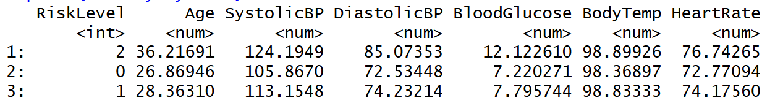
GENERATE SUMMARY STATISTICS
# show summary statistics to see differences by RiskLevel
summary_by_risk <- maternal_dt[, lapply(.SD, mean), by=RiskLevel]
print(summary_by_risk)

Slide 6
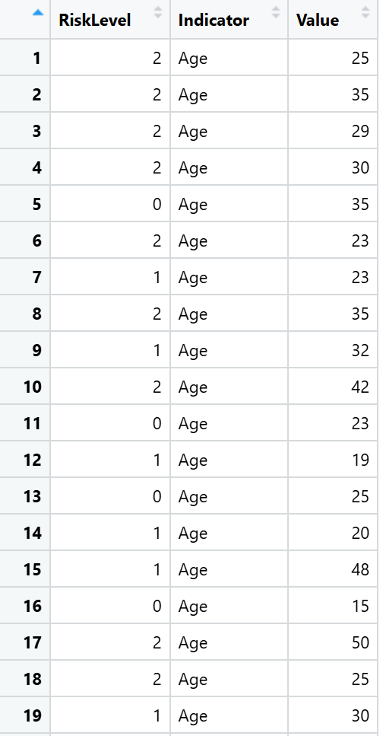
RESHAPE THE DATA
# put in long format for visualizations
maternal_long <- melt(
maternal_dt,
id.vars = "RiskLevel",
measure.vars = c("Age", "SystolicBP", "DiastolicBP", "BloodGlucose",
"BodyTemp", "HeartRate"),
variable.name = "Indicator",
value.name = "Value"
)

Slide 7
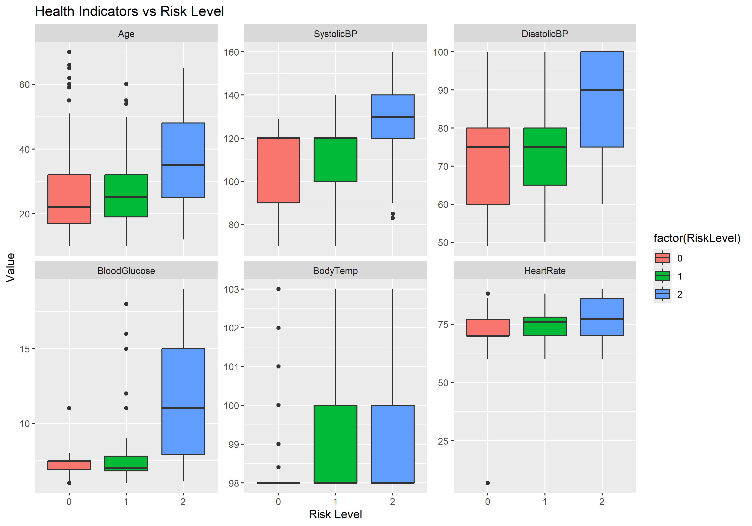
DATA VISUALIZATION
# box plot by risk level
library("ggplot2")
ggplot(maternal_long, aes(x = factor(RiskLevel),
y = Value, fill = factor(RiskLevel))) +
geom_boxplot() +
facet_wrap(~Indicator, scales = "free_y") +
labs(x = "Risk Level", y = "Value",
title = "Health Indicators vs Risk Level")
ggsave("maternal_data_visualization.png",
width = 10, height = 7)
shell.exec("maternal_data_visualization.png")

Slide 8
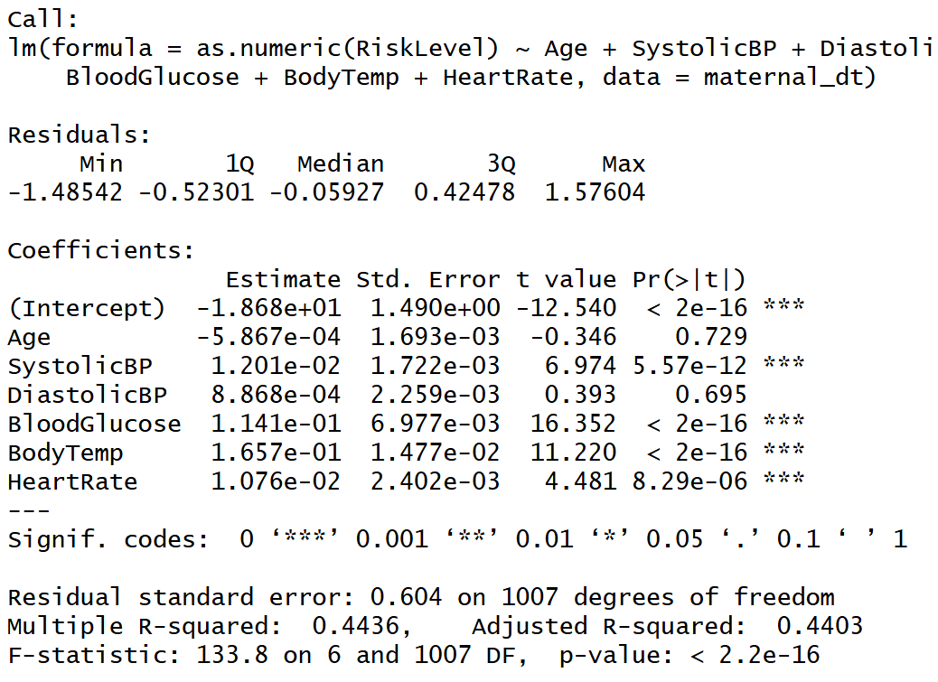
BUILD LINEAR REGRESSION MODEL
# create linear regression model for metrics against risk level
maternal_model <- lm(as.numeric(RiskLevel) ~ Age
+ SystolicBP
+ DiastolicBP
+ BloodGlucose
+ BodyTemp
+ HeartRate,
data = maternal_dt)
summary(maternal_model)

Slide 9
INTERPRETING LINEAR REGRESSION MODEL
In a linear regression model:
RiskLevel = β0 + β1*Age + β2*SystolicBP + β3*DiastolicBP + β4*BloodGlucose + β5*BodyTemp +β6*HeartRate
Those β coefficients are the weights.
A larger absolute coefficient = stronger effect on RiskLevel
A small coefficient = weak effect
A statistically significant coefficient (p < .05) = reliably contributes
The sign indicates direction (positive increases risk, negative decreases)
For every 1-unit increase in the metric (e.g., +1 mmHg in BP, +1 mg/dL glucose, +1°F temperature), the risk score changes by the coefficient amount.

Slide 10
CREATE PREDICTIVE FUNCTION
# we can calculate the coefficients from the linear model for an equation that shows the weight (influence) of each predictor
coef(maternal_model)
# create a function to plug in metrics to predict risk
predict_risk <- function(Age, SystolicBP, DiastolicBP, BloodGlucose, BodyTemp, HeartRate) {
-18.68303 + (-0.0005867 * Age) + (0.01201164 * SystolicBP) + (0.0008868 * DiastolicBP) + (0.1140881 * BloodGlucose) + (0.1656677 * BodyTemp) +
(0.0107635 * HeartRate)
}
# example
predict_risk(Age = 35, SystolicBP = 120, DiastolicBP = 90, BloodGlucose = 15, BodyTemp = 98, HeartRate = 85)
> 1.87
round(predict_risk(35, 120, 75, 15, 98, 85))
> 2

Slide 11
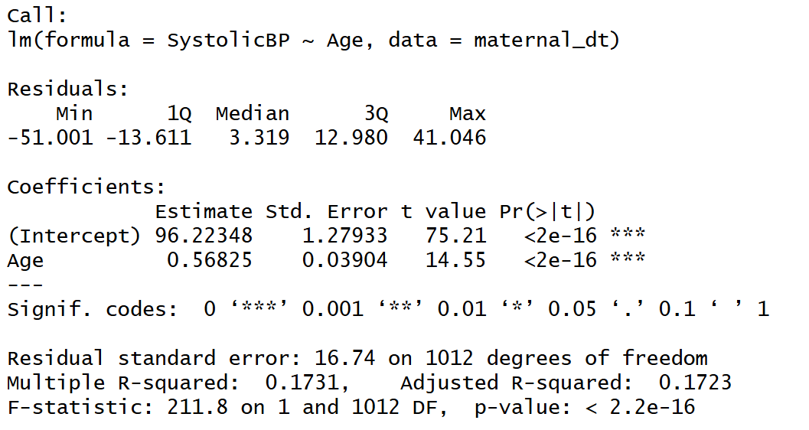
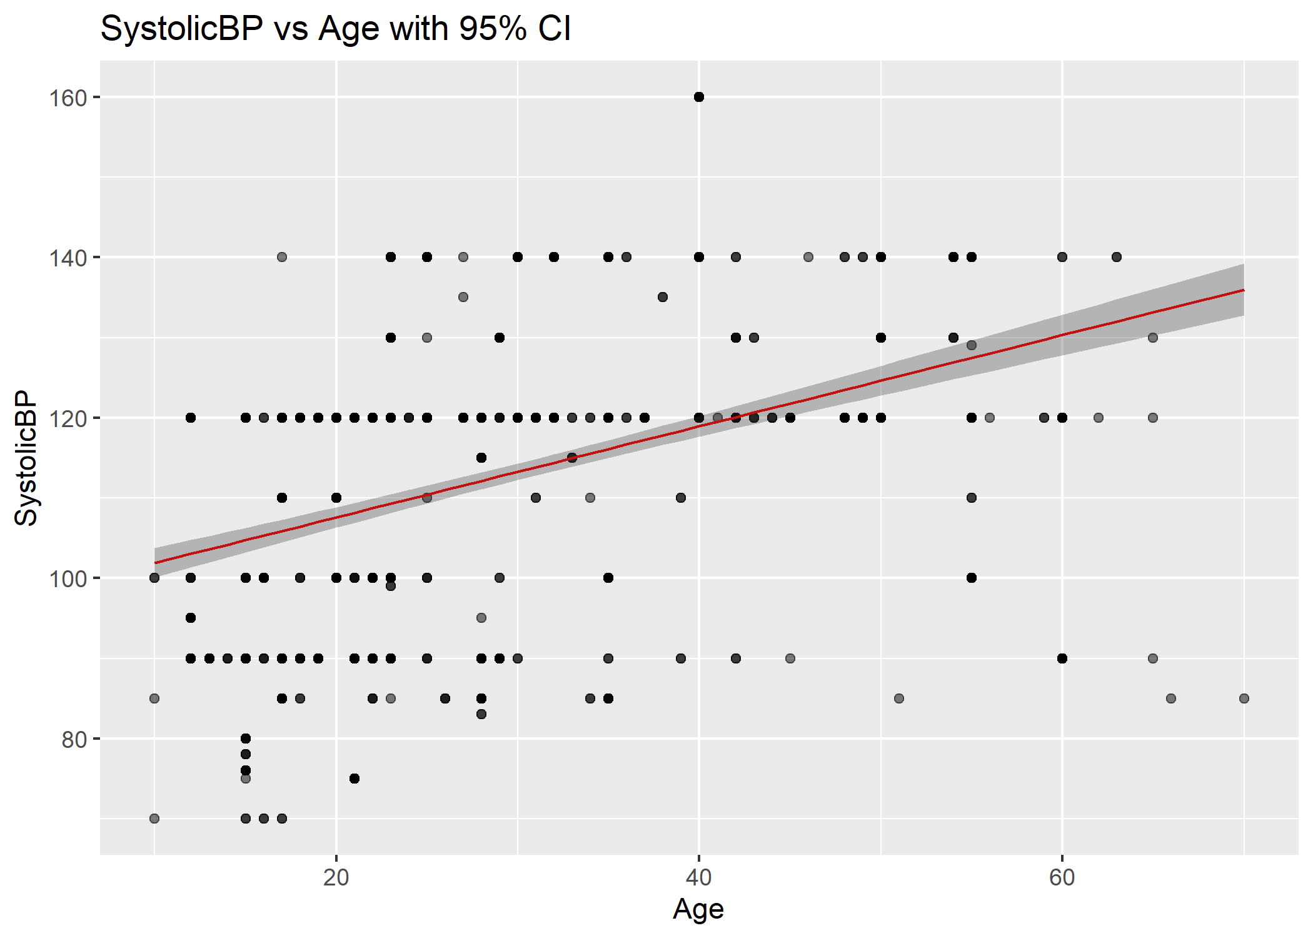
FIT LINEAR MODELS FOR EACH METRIC COMPARED TO AGE
# Create linear model for metrics over age, then predict with confidence interval and plot
# SystolicBP vs Age
lm_sys <- lm(SystolicBP ~ Age, data = maternal_dt)
pred_sys <- predict(lm_sys, interval = "confidence")
summary(lm_sys)
ggplot(maternal_dt, aes(x = Age, y = SystolicBP)) +
geom_point(alpha = 0.5) +
geom_line(aes(y = pred_sys[, "fit"]), color = "red") +
geom_ribbon(aes(ymin = pred_sys[, "lwr"], ymax = pred_sys[, "upr"]), alpha = 0.3) +
labs(title = "SystolicBP vs Age with 95% CI", x = "Age", y = "SystolicBP")
ggsave("SystolicBP_vs_Age.png", width = 7, height = 5)
shell.exec("SystolicBP_vs_Age.png")

Slide 12
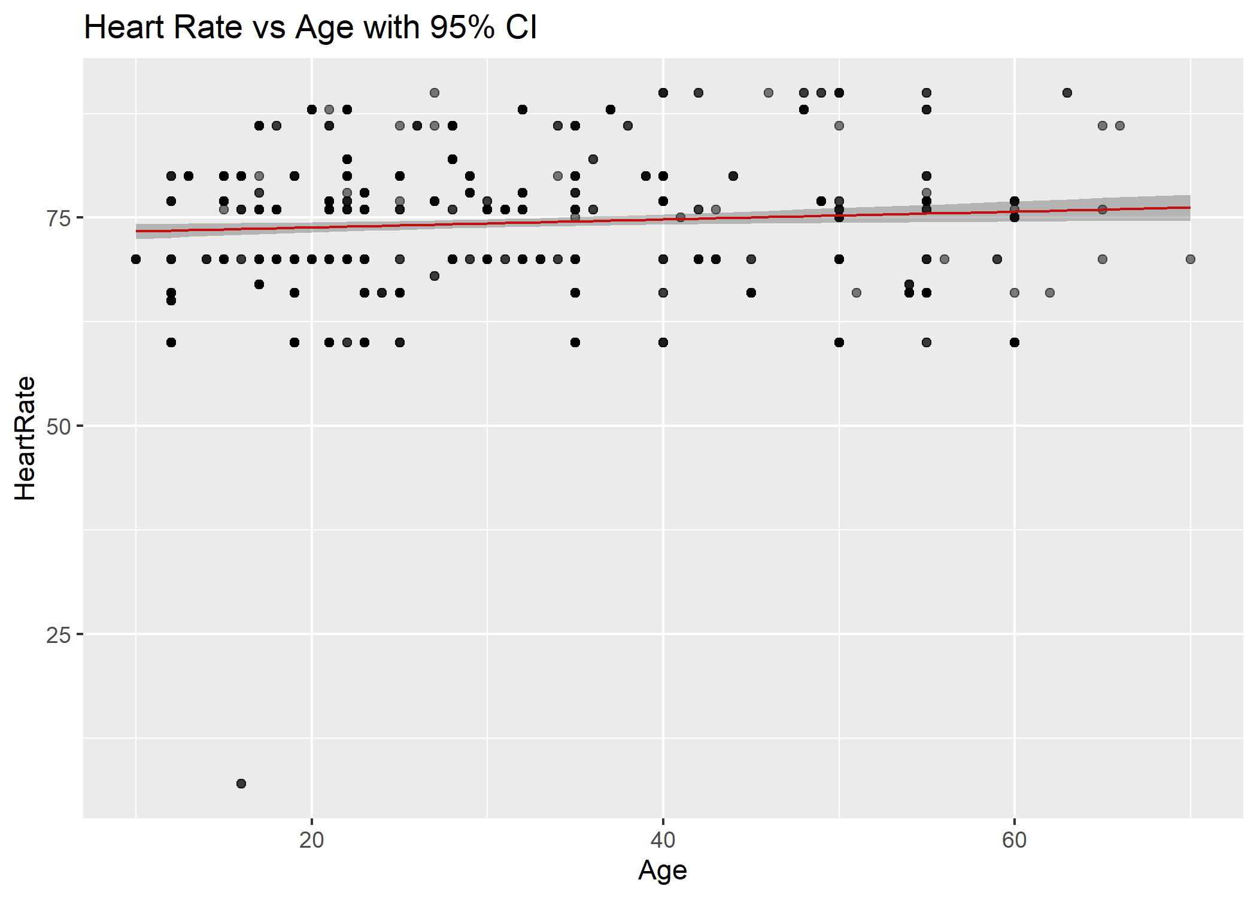
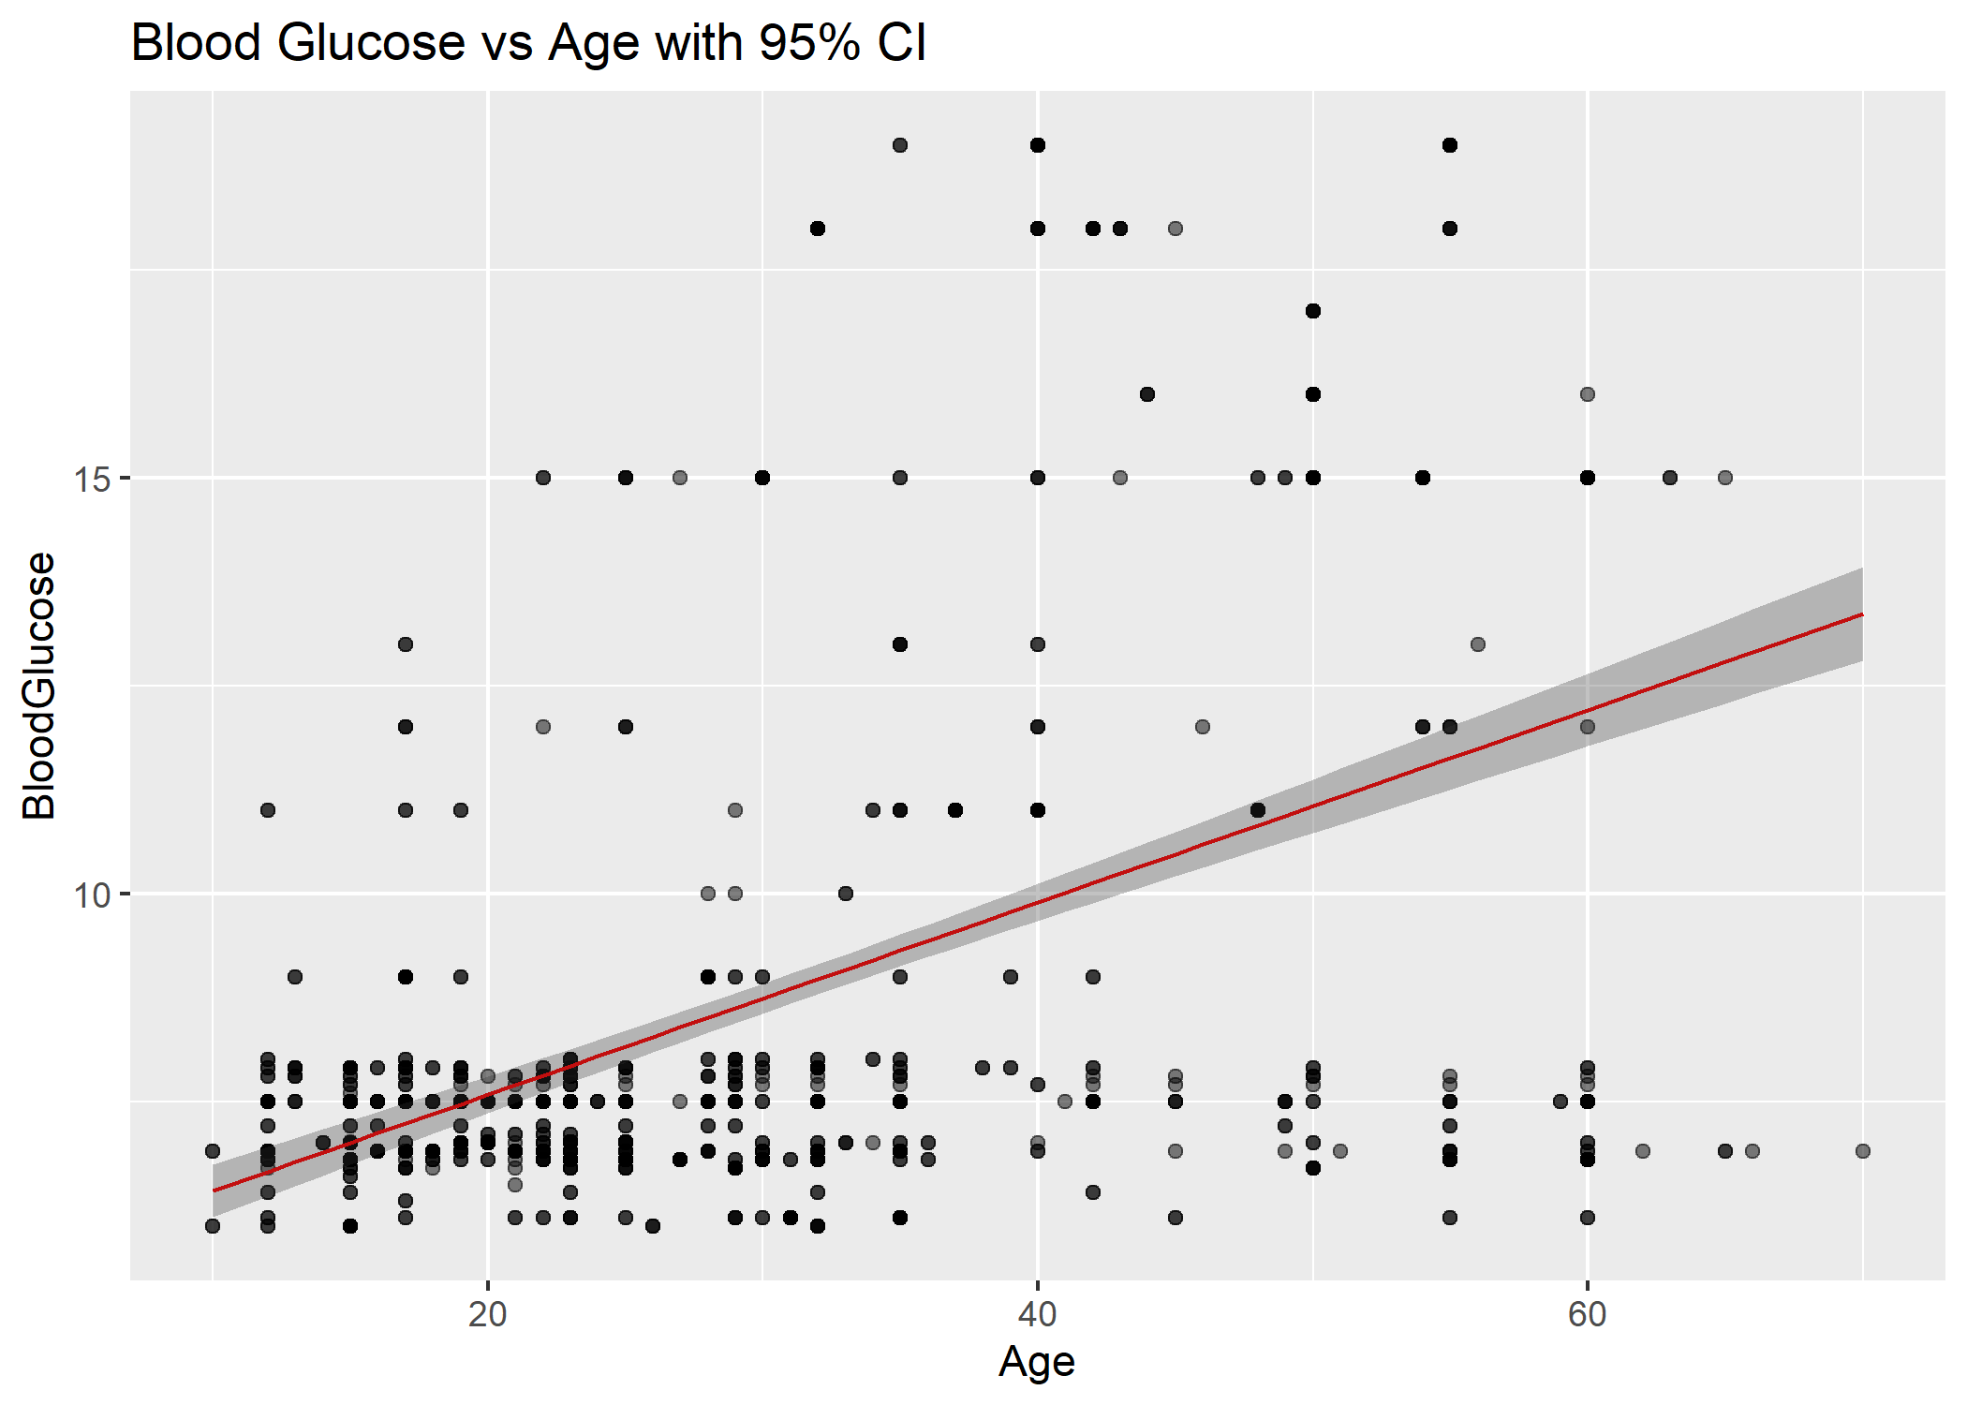
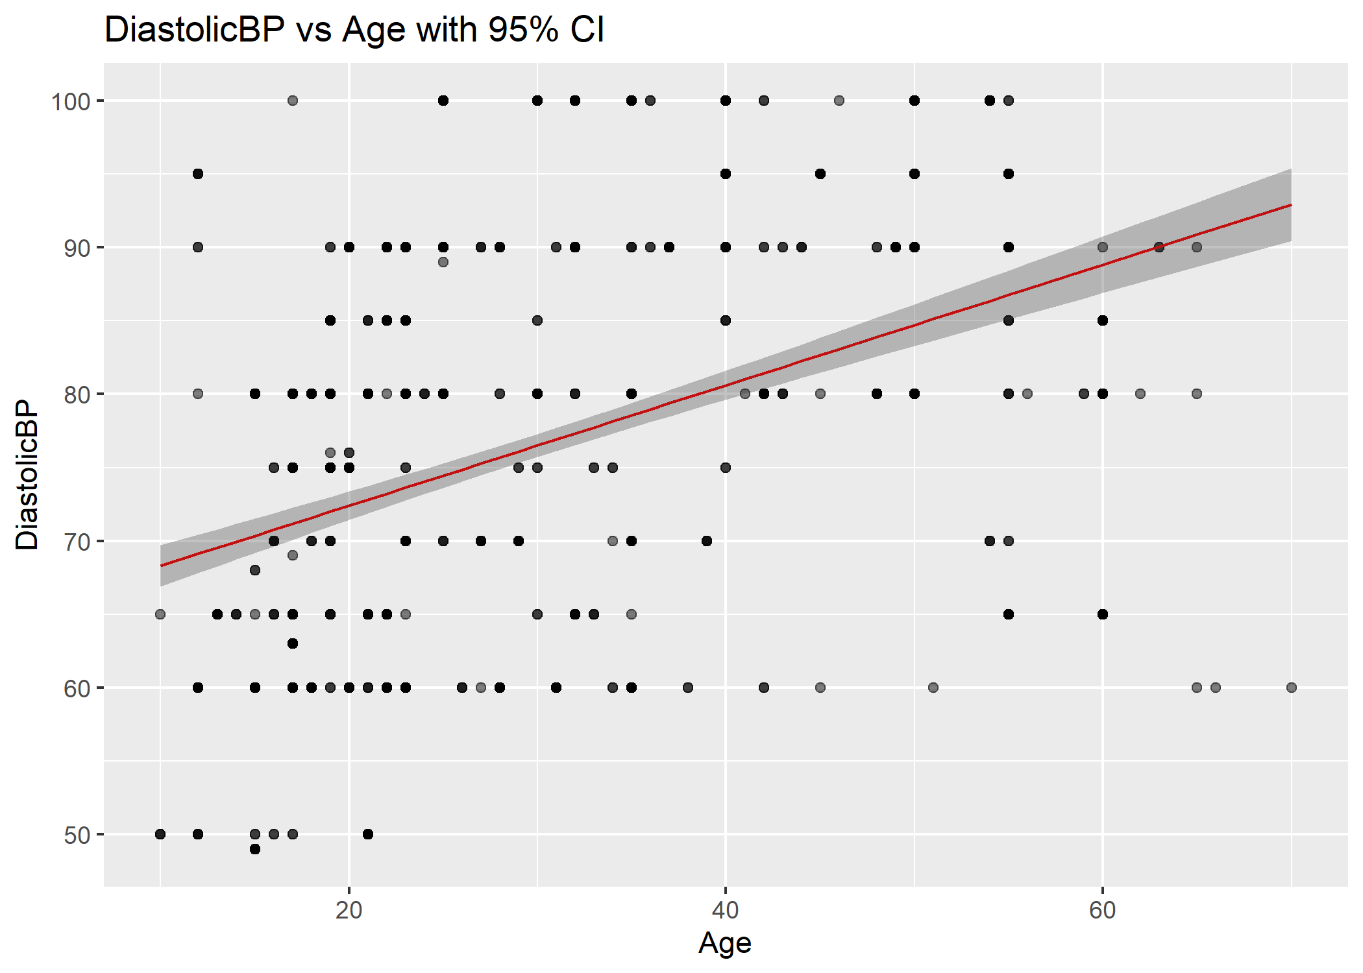
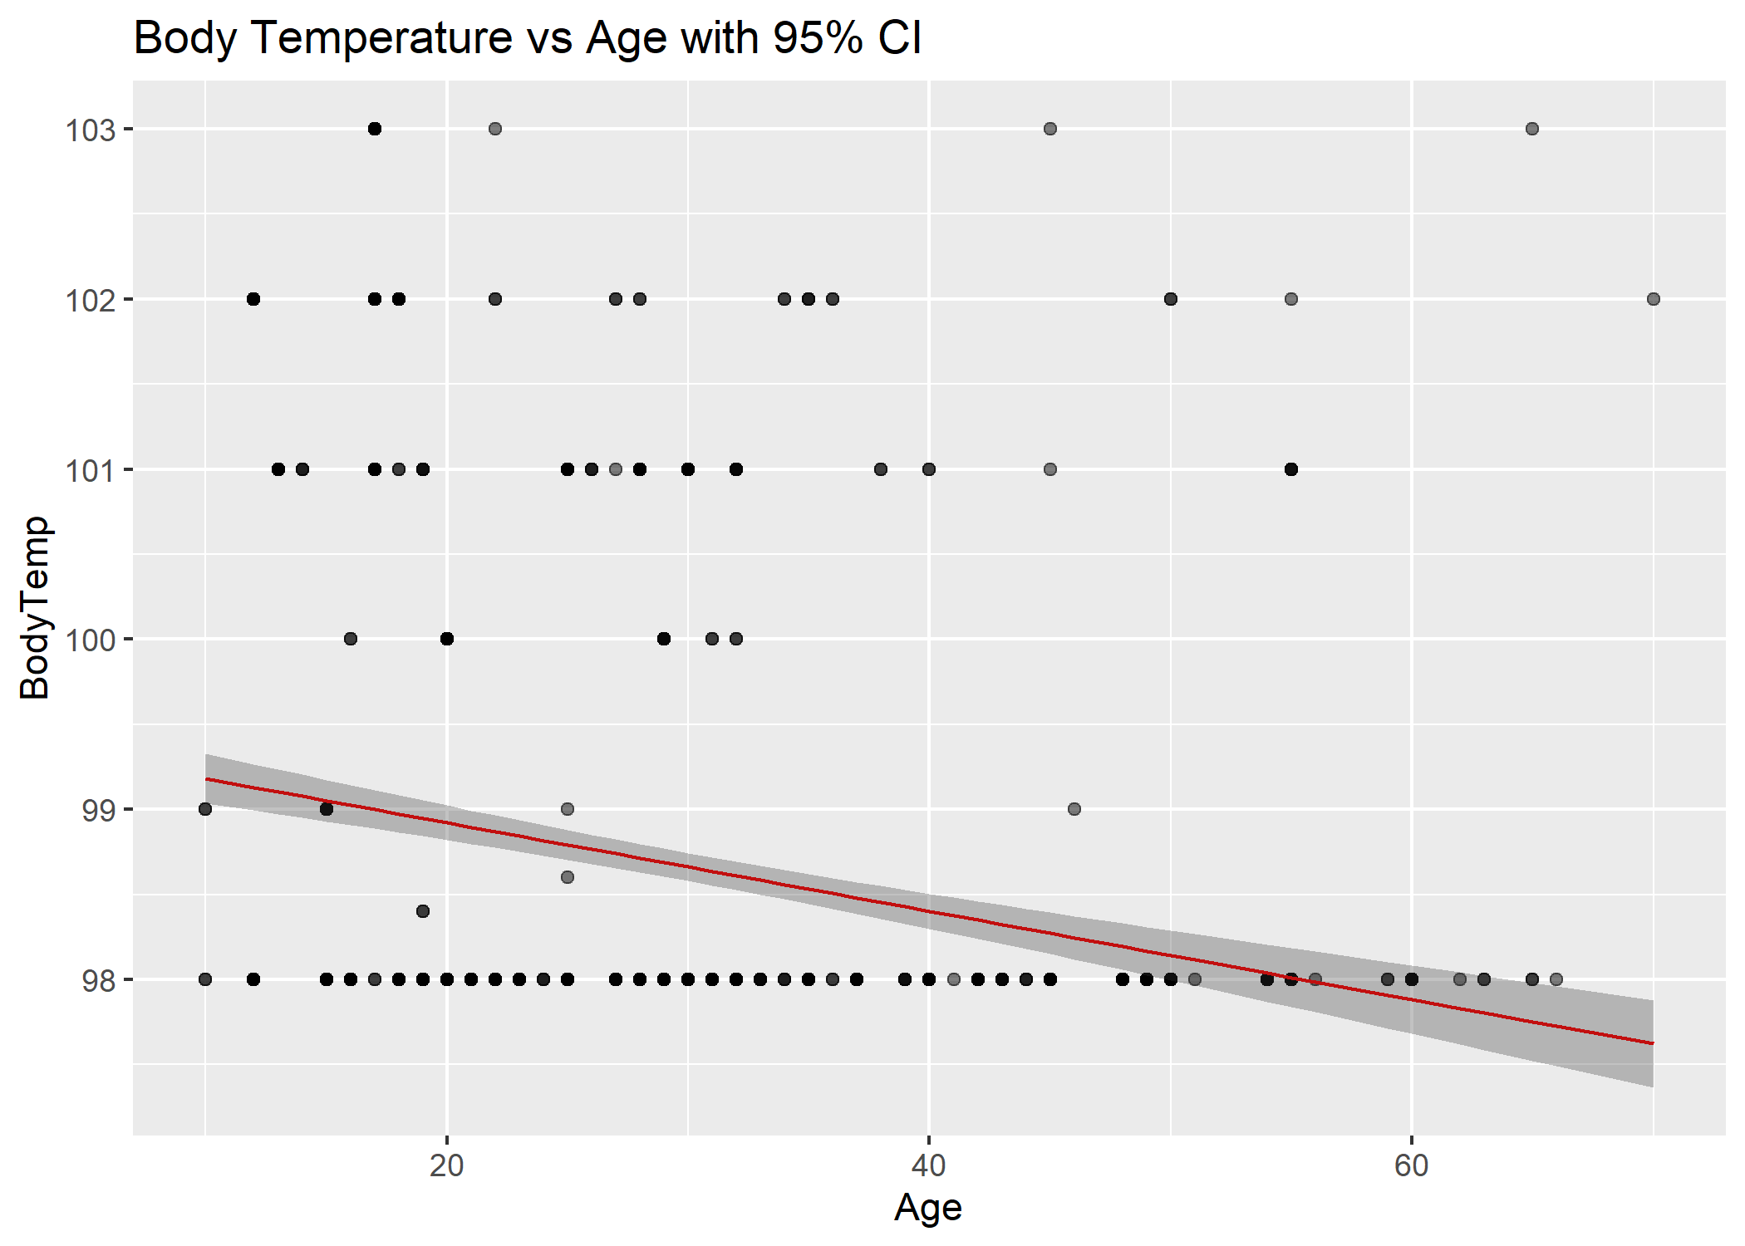
FIT LINEAR MODELS FOR EACH METRIC COMPARED TO AGE

Slide 13
Questions?

